Slide 1
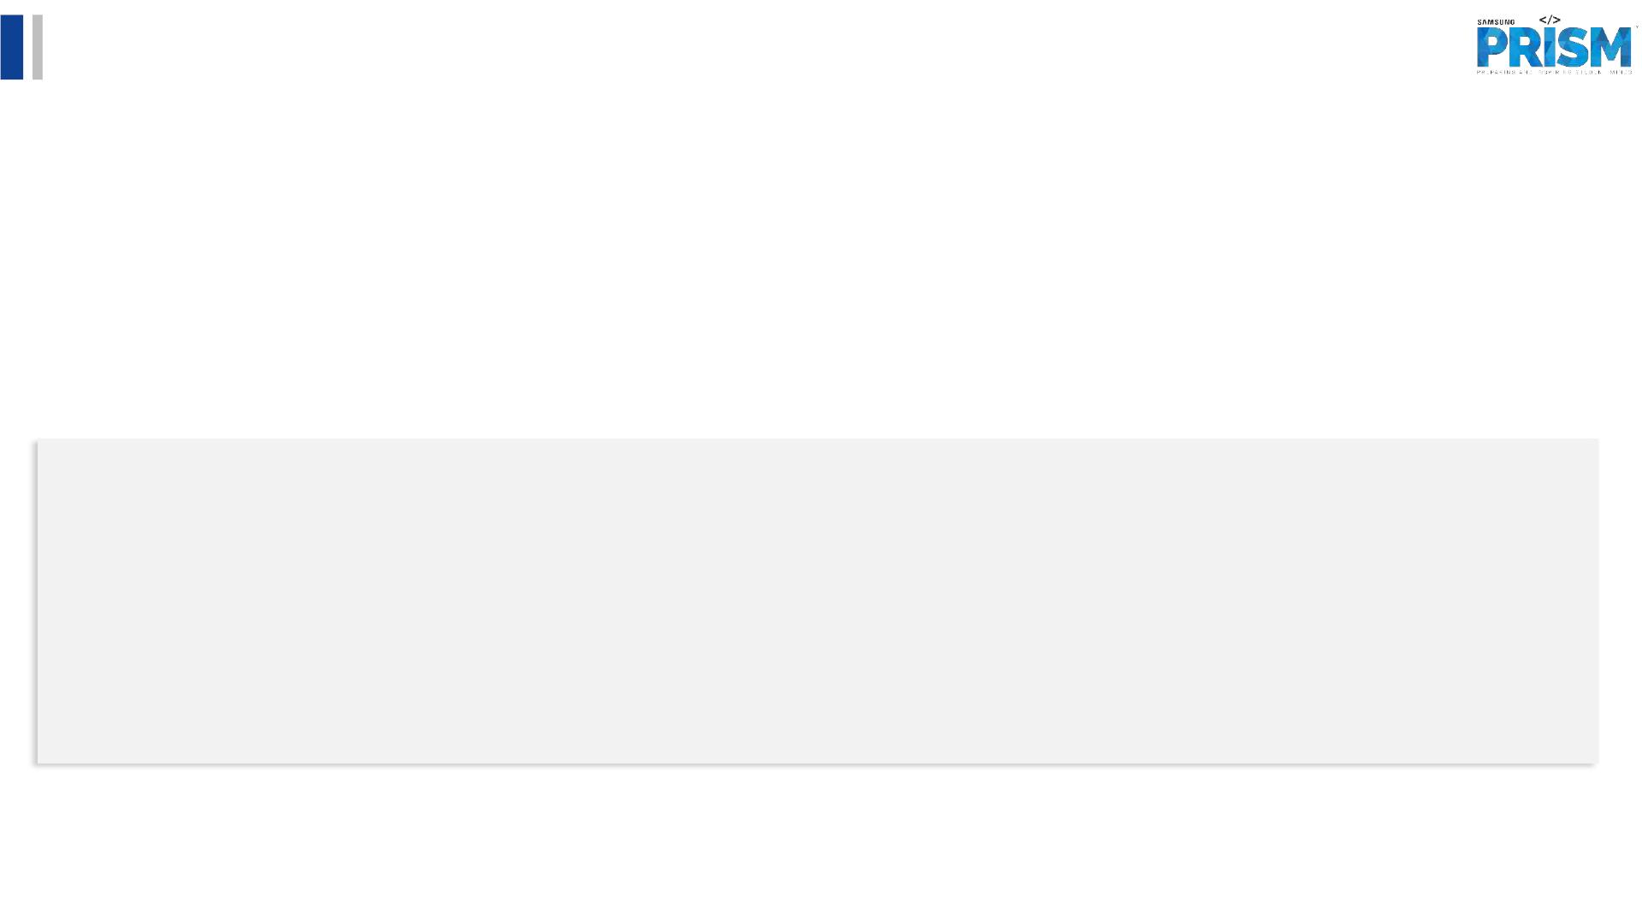
[Samsung PRISM] Weekly Review
AI/ML Based Network Device Software
upgrade in SDN Controlled Network
Team
1. College Professor(s): Dr.P. PRAKASAM / prakasam.p@vit.ac.in
2. Students:
1. SAKSHI A. RAGHAVAN / sakshiraghavan.a2020@vitstudent.ac.in
2. JAYA SRI KRISHNA.S/ jayasri.krishna2020@vitstudent.ac.in
3. JANARTHANAN.P.M / janarthanan.pm2020@vitstudent.ac.in
3. Department: ECE
18 November 2022

Slide 2
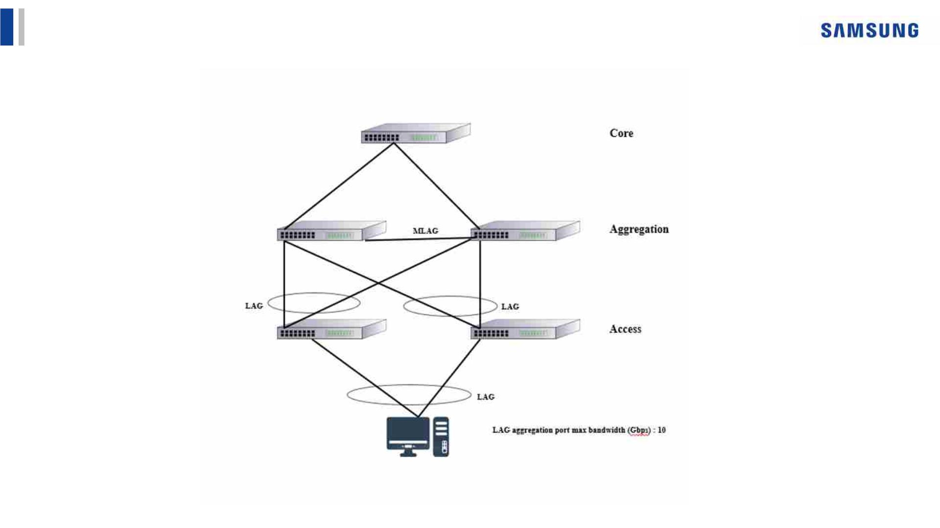
CSW23 | AI/ML Based Network Device Software upgrade in SDN Controlled Network
ARCHITECTURE
e
18 November 2022

Slide 3
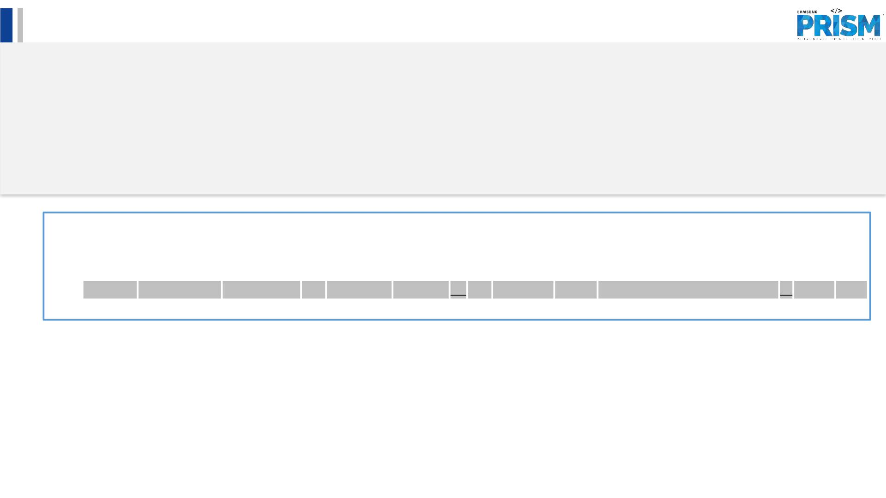
Literature survey and study
• Major Observations / Conclusions:
(provide details about your findings, experimental opinion – Use separate slide if necessary)
q Xuyuntao Zhang, Shuaiyong Li, Cha Zhang,“Short-Term Prediction of SDN Network Traffic Based on CEEMDAN and
Mixed Kernel Least Squares Support Vector Machine”, 2022 5th International Conference on Pattern Recognition
and Artificial Intelligence (PRAI), ISBN 978-1-6654-9916-3, 978-1-6654-9915-6, (http://surl.li/dmgcg)
PUBLICATION YEAR: 2022
The main contribution of the paper includes:
(1) The paper proposes a combined prediction model combining decomposition algorithm, hybrid kernel least squares support vector
machine, and optimization algorithm, considering the characteristics of network traffic such as nonlinearity and non-smoothness.
(2) Through experimental comparison, the prediction accuracy of the proposed model (CEEMDAN-FCM-LSSVM-ABC) is better than
that of CEEMDAN-LSSVM, EMD-LSSVM, LSSVM, and other models.
18 November 2022

Slide 4
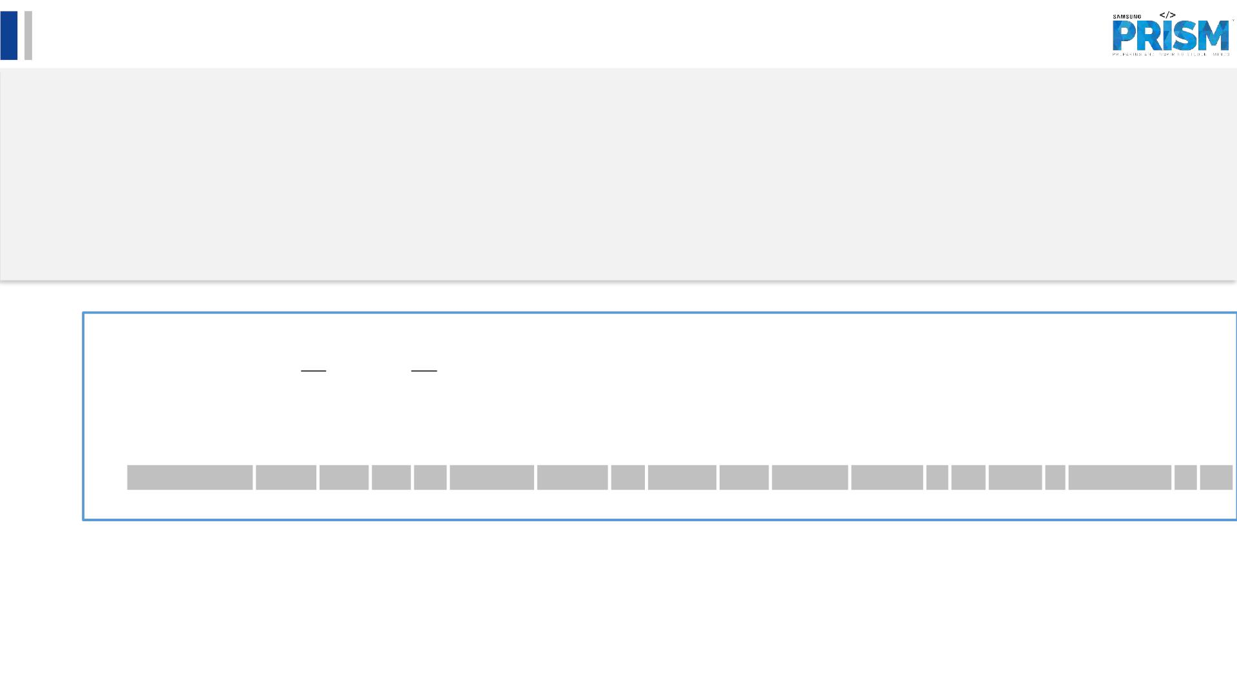
Literature survey and study
• Major Observations / Conclusions:
(provide details about your findings, experimental opinion – Use separate slide if necessary)
q Richard Etengu, Saw ChinTan, Teong Che Chuah, Jaime Galan-Jimenez, “Deep Learning-Assisted Traffic Prediction
in Hybrid SDN/OSPF Backbone Networks”, NOMS 2022-2022 IEEE/IFIP Network Operations and Management
Symposium, ISBN: 978-1-6654-0601-7, (http://surl.li/dmgdu )
PUBLICATION YEAR: 2022
The paper’s gist:
(1) This paper proposes an improved DL framework that utilizes different dimensionality feature reduction techniques to perform short
-term TM prediction in SDN networks.
(2) The two dimensionality reduction techniques required to perform feature reduction for the DL model are correlation component
analysis (CCA) and principal component analysis (PCA).
(3) Investigational results show that the proposed method can achieve more accurate forecast of link traffic in comparison to the
traditional baseline machine learning frameworks.
18 November 2022

Slide 5
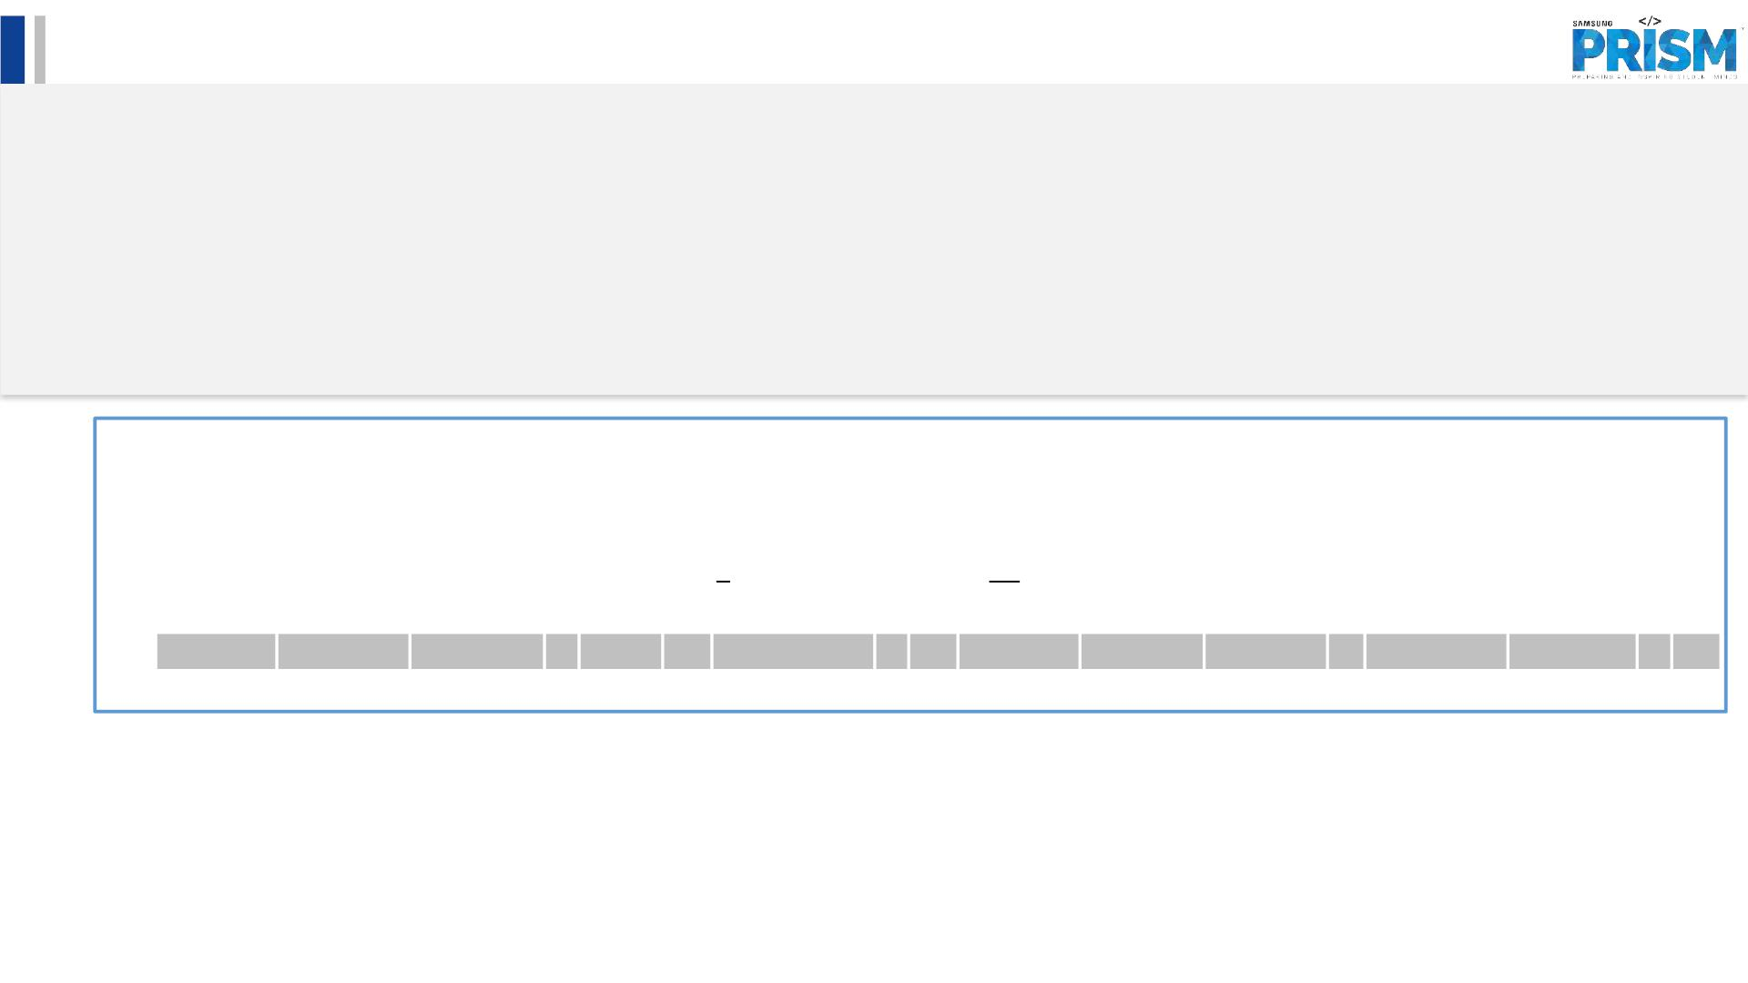
Literature survey and study
• Major Observations / Conclusions:
(provide details about your findings, experimental opinion – Use separate slide if necessary)
q Abdullah Baz, “Bayesian Machine Learning Algorithm for Flow Prediction in SDN Switches” 2018 1st International
Conference on Computer Applications & Information Security (ICCAIS): ISBN: 978-1-5386-4427-0
(http://surl.li/dmgfa)
The paper’s gist:
(1) Segregation of data and control plans impose latency and overheads to SDN-based networks as a Networking Function Device (NFD
aka Switch) needs to consult the controller how to handle each traffic.
(2) In order to overcome such shortcoming of SDN, this paper makes use of the Bayesian Machine Learning (BML) to allow switches to
infer the underlying stochastic process by which controller classifies packets into flows.
(3) Extensive simulation conducted to assess the performance of the proposed algorithm highlights its advantages compared to the
standard mechanism defined in the-state-of-the-art SDN implementation.
18 November 2022

Slide 6
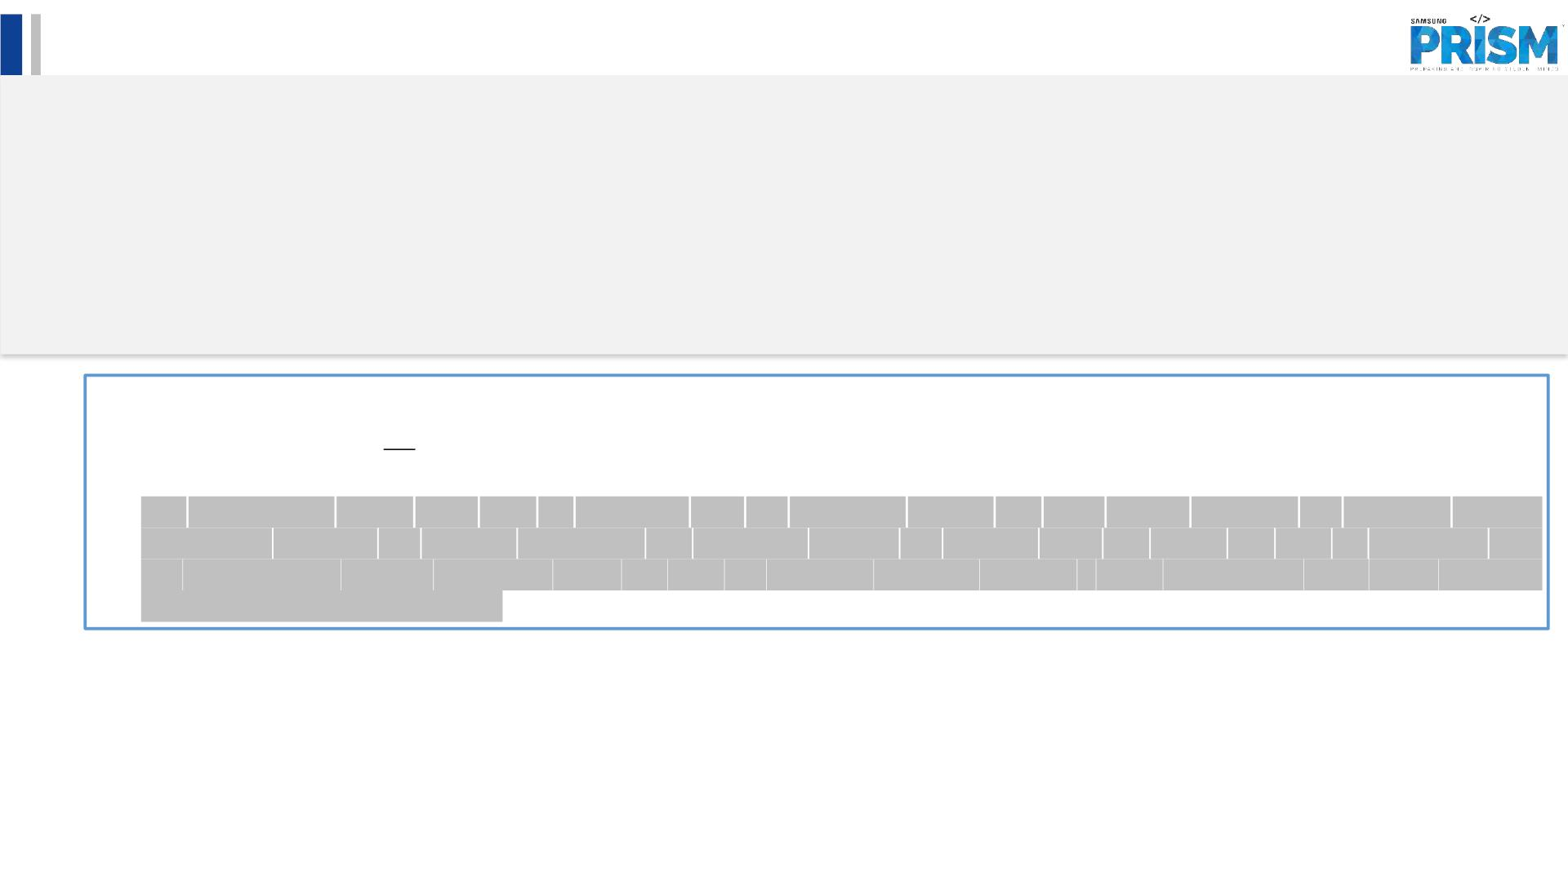
Literature survey and study
• Major Observations / Conclusions:
(provide details about your findings, experimental opinion – Use separate slide if necessary)
q L. Huang, Y. Wang, M. Ye, H. Qiu, X. Deng, X. Xue, “Intelligent routing method based on Dueling DQN
reinforcement learning and network traffic state prediction in SDN”, In: Wireless Networks. (Wireless Networks,
2022), ISSN: 15728196, (https://rb.gy/n7qp1w)
The paper’s gist:
(1) This paper proposes an intelligent routing method based on the Software Defined Network (SDN), Dueling DQN (a Deep
Reinforcement Learning algorithm) and network traffic state prediction.
(2) The experimental results show that: (1) compared with the traditional Dijkstra and OSPF routing methods, the proposed method
significantly improves the network throughput and effectively reduces the network delay and packet loss rate; (2) comparing with
the reinforcement learning algorithms DDPG and PPO, the proposed approach achieves a faster convergence state, which improves
the efficiency of network routing.
18 November 2022

Slide 7
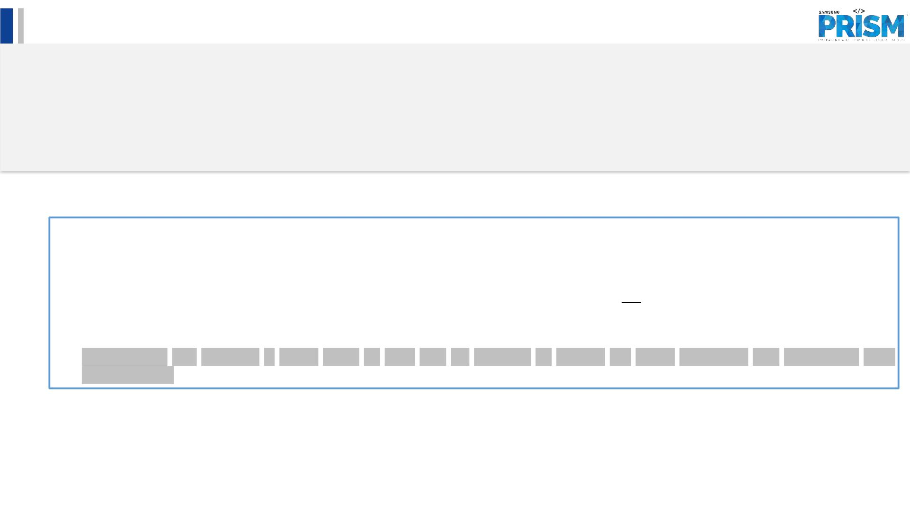
Literature survey and study
• Major Observations / Conclusions:
(provide details about your findings, experimental opinion – Use separate slide if necessary)
q Sowmya Sanagavarapu, Sashank Sridhar, “SDPredictNet-A Topology based SDN Neural Routing Framework with
Traffic Prediction Analysis”, Computing and Communication Workshop and Conference (CCWC), 2021 IEEE 11th
Annual. :0264-0272 Jan, 2021, ISBN: 978-1-6654-1490-6, (https://rb.gy/tvfenr)
The paper’s gist:
(1) The dynamic nature of traffic in these networks with multi-layer switches hinder the efficiency of SDN's performance in multi-cloud
environments.
(2) This paper proposes SDPredictNet, a Recurrent Neural Network framework deployed on the SDN Controller that can predict the
traffic in the network and update flow tables of the higher layer switches to perform routing based on the perceived bottlenecks in
the network.
(3) SDPredictNet has achieved a RMSE score of 0.07 and an accuracy of 99.88% for traffic estimation and subsequent path
determination.
root-mean-square error (RMSE)
18 November 2022

Slide 8
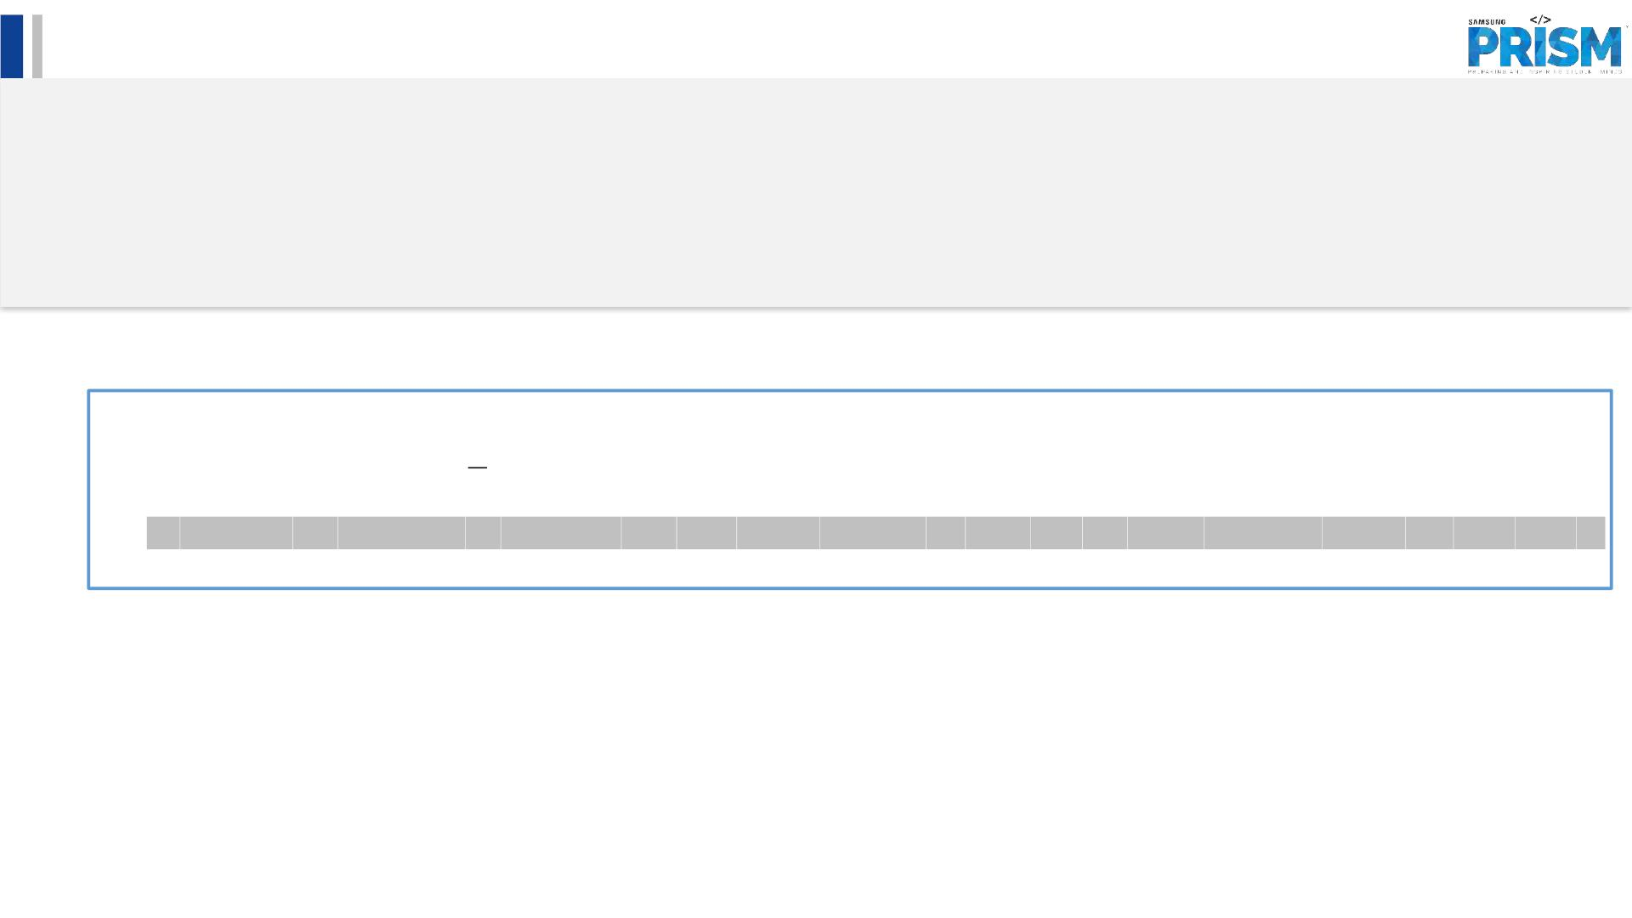
Literature survey and study
• Major Observations / Conclusions:
(provide details about your findings, experimental opinion – Use separate slide if necessary)
q A. Azzouni, G. Pujolle, “NeuTM: A neural network-based framework for traffic matrix prediction in SDN”, In:
IEEE/IFIP Network Operations and Management Symposium: Cognitive Management in a Cyber World, NOMS 6
July 2018, ISBN: 9781538634165, (https://rb.gy/hilhap)
The paper’s gist:
(1) This paper presents NeuTM, a framework for network Traffic Matrix (TM) prediction based on Long Short-Term Memory Recurrent
Neural Networks (LSTM RNNs).
(2) By validating our framework on real-world data from GEANT network, we show that our model converges quickly and gives state of
the art TM prediction performance.
18 November 2022

Slide 9
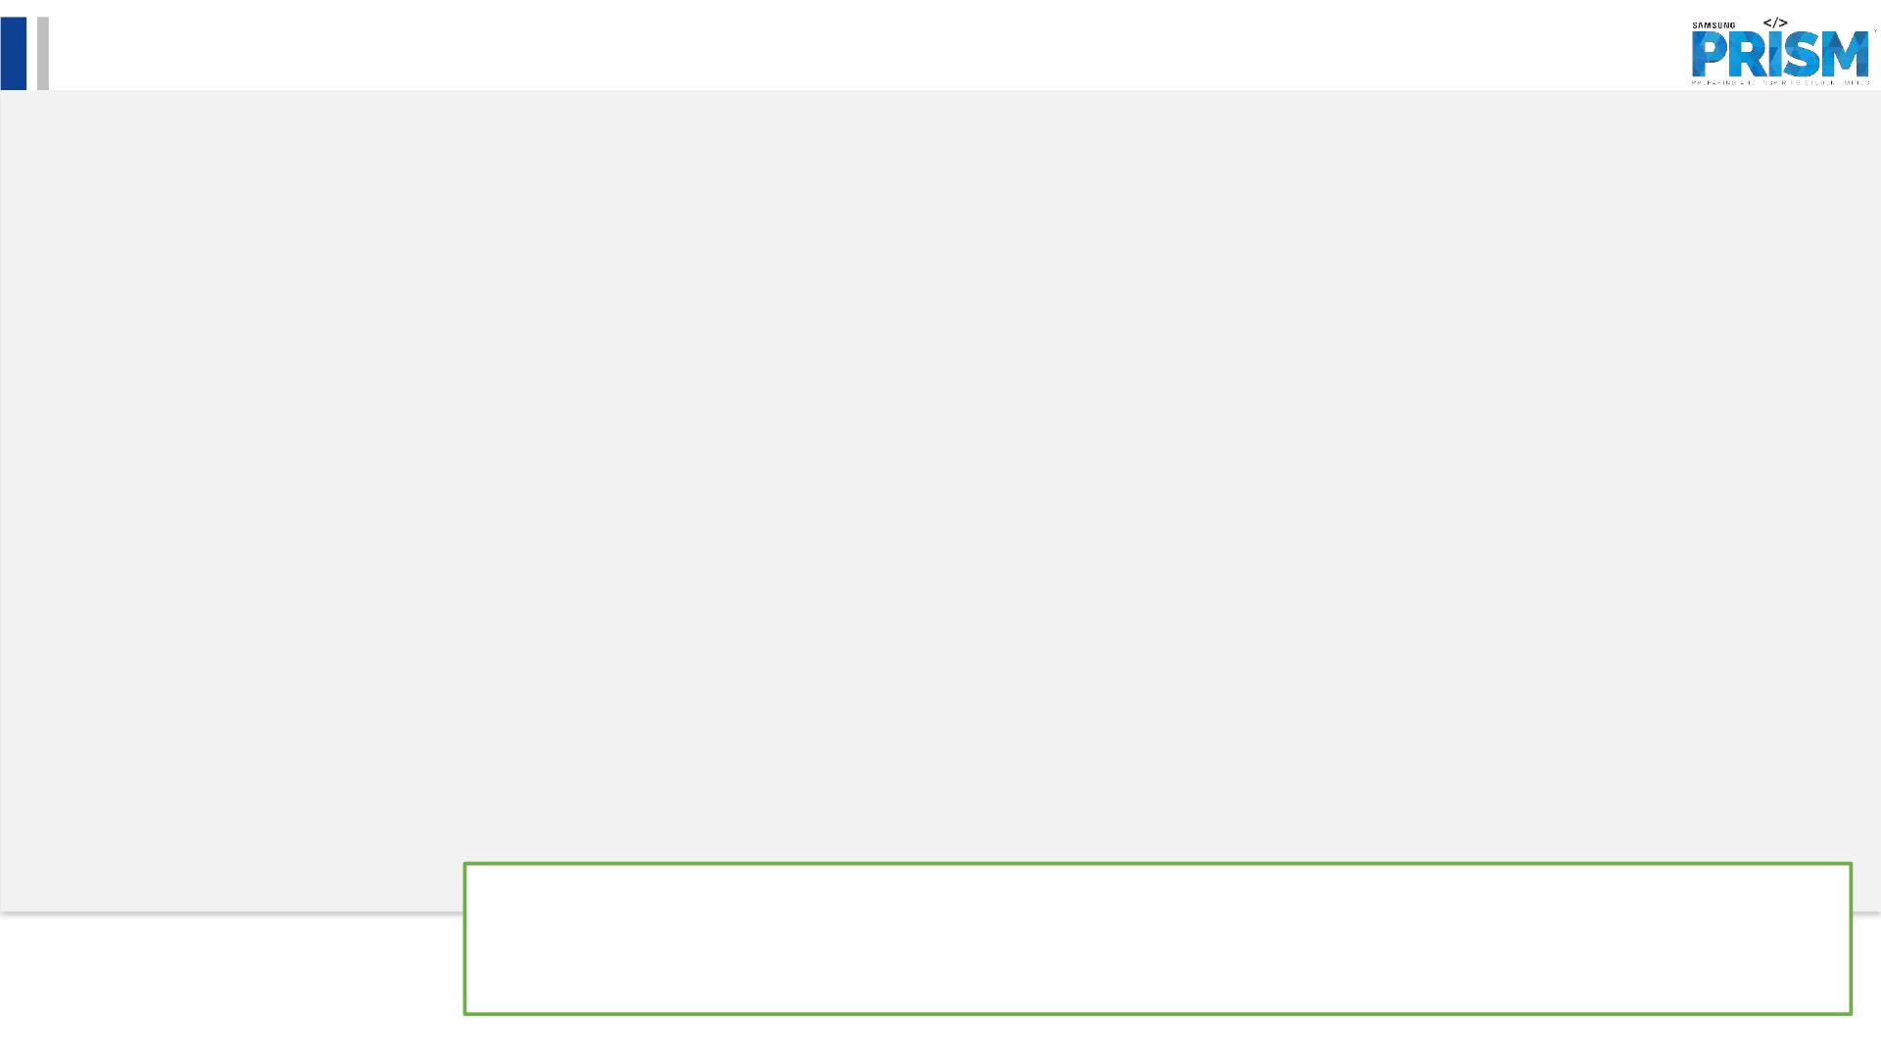
Literature survey and study
• Major Observations / Conclusions:
(provide details about your findings, experimental opinion – Use separate slide if necessary)
• Bi-LSTM Model Vs Uni-directional LSTM Model
In bidirectional, our input flows in two directions, making a bi-lstm different from the regular
LSTM.
Every component of an input sequence has information from both the past and present.
For this reason, BiLSTM can produce a more meaningful output, combining LSTM layers from both
directions
• LSTM Model Vs ARIMA and Sarima
“Long short-term memory (LSTM), one of the recurrent neural networks (RNN), has been
incontestable to outperform typical prediction methods.” ¹
“The LSTM-based models are incorporated with further "gates" such that it will consider input
data of longer sequences. LSTM-based models outperform Autoregressive Integrated Moving
Average models attributable to these further capabilities (ARIMA). “¹
¹ M. Pirani, P. Thakkar, P. Jivrani, M. H. Bohara and D. Garg, "A Comparative Analysis of ARIMA, GRU, LSTM
and BiLSTM on Financial Time Series Forecasting," 2022 IEEE International Conference on Distributed
Computing and Electrical Circuits and Electronics (ICDCECE), 2022, pp. 1-6, doi:
10.1109/ICDCECE53908.2022.9793213.
18 November 2022

Slide 10
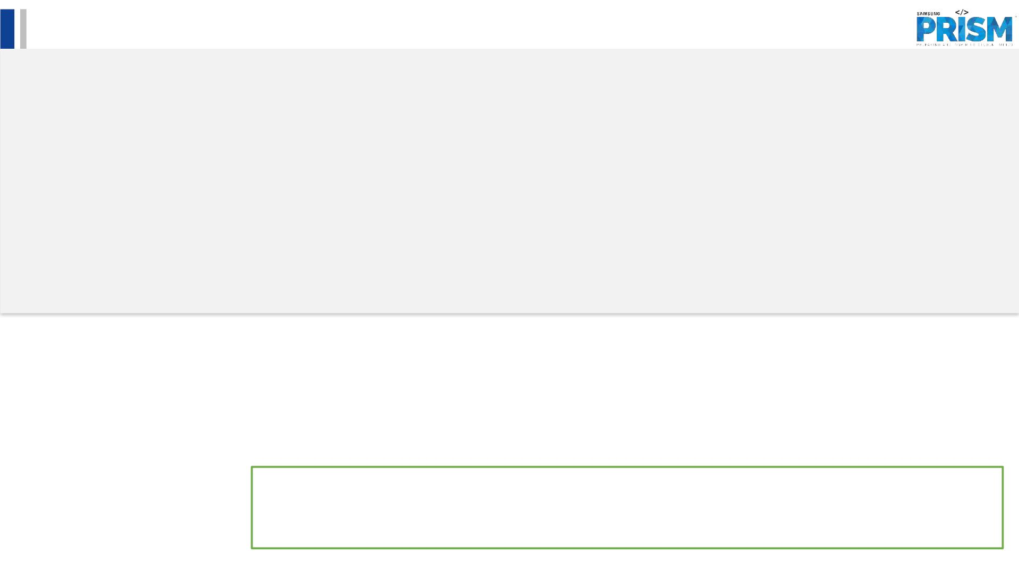
Literature survey and study
• Major Observations / Conclusions:
(provide details about your findings, experimental opinion – Use separate slide if necessary)
• LSTM Model Vs ARIMA and Sarima
“Both in terms of learning how it works, and the implementation, the LSTM-model provides
considerably more options for fine-tuning compared to ARIMA.” ²
“Machine learning problems with substantial dataset, its found that the average reduction in error
rates obtained by LSTM is between 84–87 percent when compared to ARIMA indicating the
superiority of LSTM to ARIMA.“²
² https://techairesearch.com/arima-sarima-vs-lstm-with-ensemble-learning-insights-for-time-series-data/
18 November 2022

Slide 11

Literature survey and study
• Major Observations / Conclusions:
(provide details about your findings, experimental opinion – Use separate slide if necessary)
• LSTM Model Vs ARIMA and Sarima
“..Long Short-Term Memory (LSTM) from ANN chooses and outputs compared with the
autoregressive integrated moving average (ARIMA) model. The results show, although, in long
term prediction, the forecast accuracy of both models reduce, LSTM outperforms ARIMA, in terms
of error of accuracy, significantly.” ³
• SARIMA is only suitable for stationary time series data and short-term prediction and LTSM helps us to overcome
these shortcomings of SARIMA.
³ Abdoli, Ghahreman, “Comparing the Prediction Accuracy of LSTM and ARIMA Models for Time-Series with
Permanent Fluctuation” (May 28, 2020). Periódico do Núcleo de Estudos e Pesquisas sobre Gênero e
DireitovCentro de Ciências Jurídicas - Universidade Federal da Paraíba, V. 9 - Nº 02 - Ano 2020, Available at
SSRN: https://ssrn.com/abstract=3612487 or http://dx.doi.org/10.2139/ssrn.3612487
18 November 2022

Slide 12
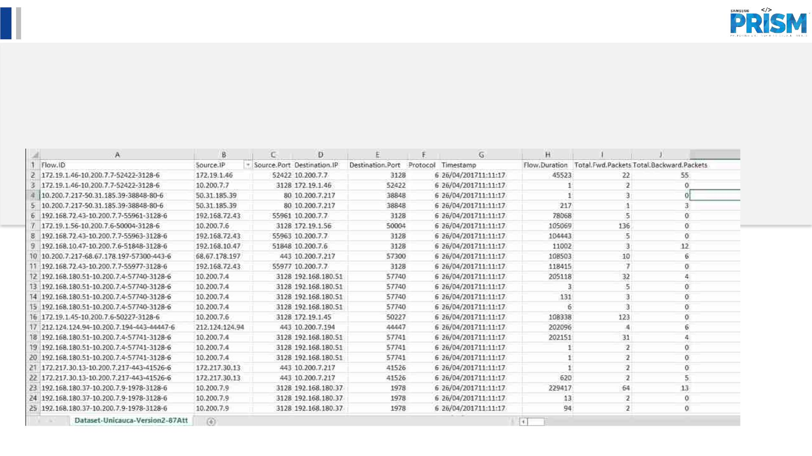
Literature survey and study
• Major Observations / Conclusions:
(provide details about your findings, experimental opinion – Use separate slide if necessary)
DATASET FOUND:
q Site:
https://www.kaggle.com/datasets/jsrojas/ip-network-traffic-flows-labeled-with-87-apps
18 November 2022

Slide 13
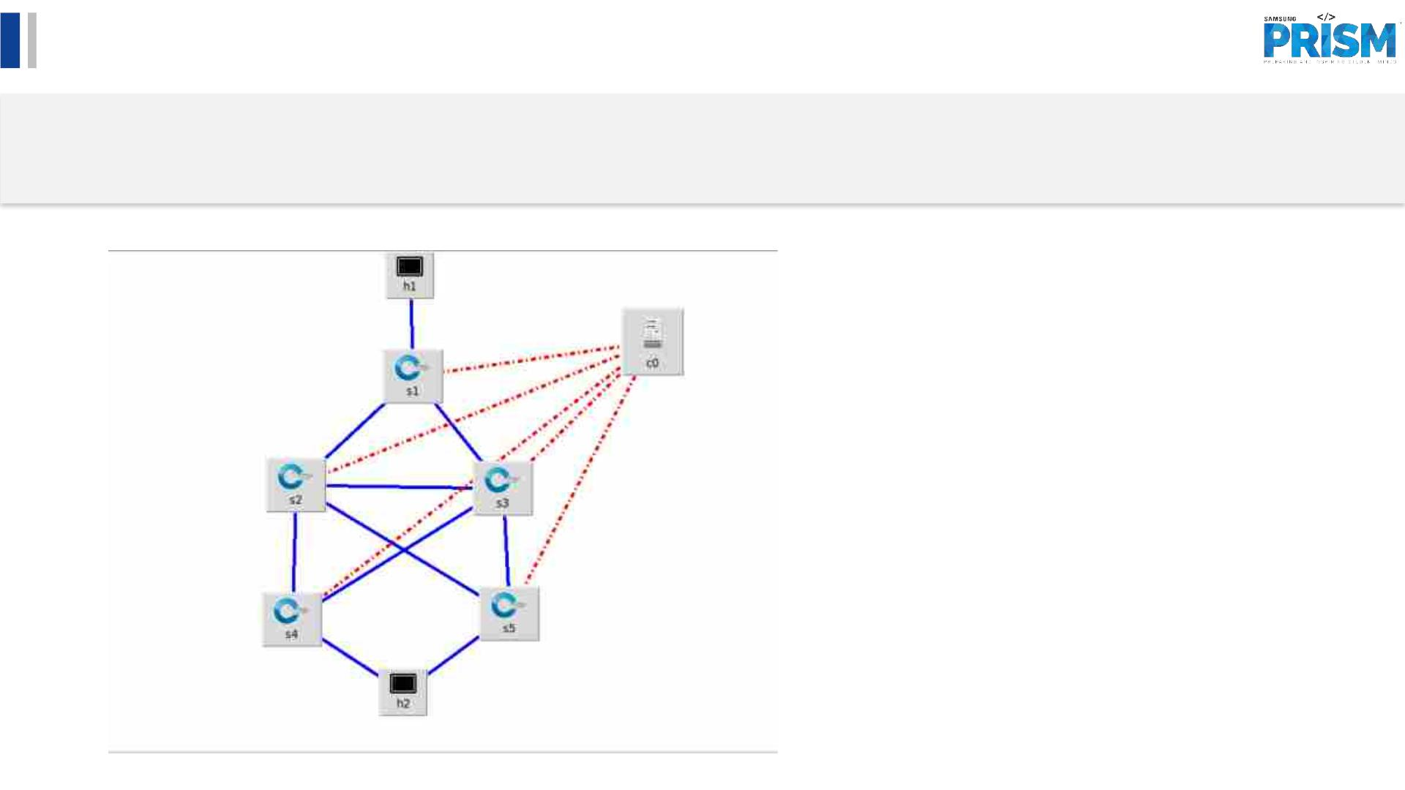
Queries
• Challenges :
(Discuss in the form of bullets, what are the next action steps, any road blocks / bottlenecks)
• Created topology in mininet:
18 November 2022

Slide 14

Thank you
18 November 2022

